Slide 1
COUNTERS
A counter is a device which stores (and sometimes displays) the number of times a particular event or process has occurred, often in relationship to a clock.
A counter circuit is usually constructed with a number of flip-flops connected in cascade.
Counters are a very widely used component in digital circuits, and are manufactured as separate integrated circuits and also incorporated as parts of larger integrated circuits.
Counters are broadly divided into two categories
  Asynchronous counter
  Synchronous counter

Slide 2
Design of synchronous counters

Slide 5
Design a three-bit counter that counts in the sequence 0, 1, 2, 4, 5, 6, 0, ……

Slide 8
Synchronous up/down counter

Slide 9
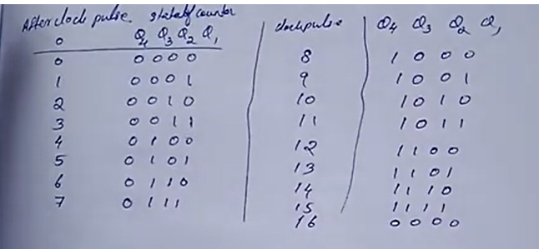
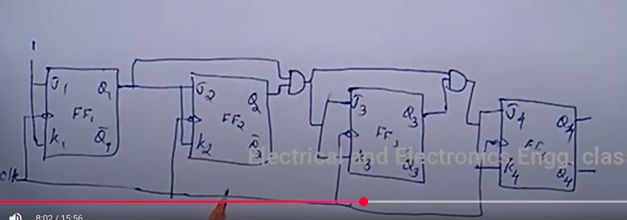
Synchronous up counter

Slide 10
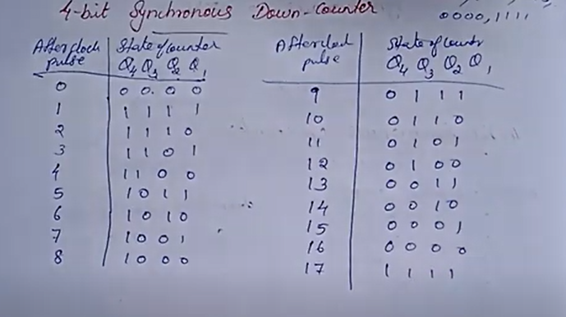
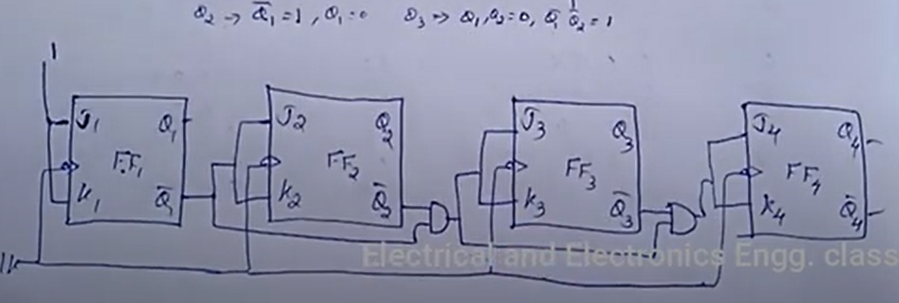
Synchronous down counter

Slide 11
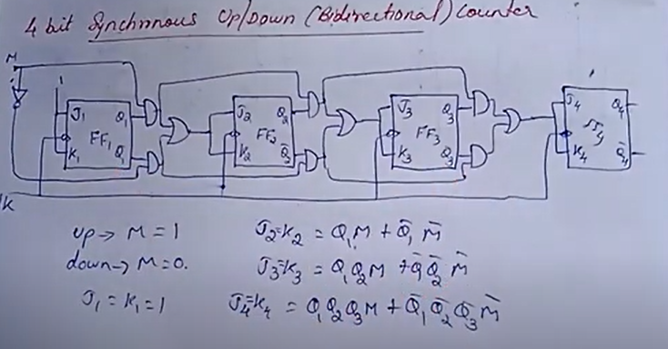
Synchronous up/down counter

Slide 12
Problem

Slide 13
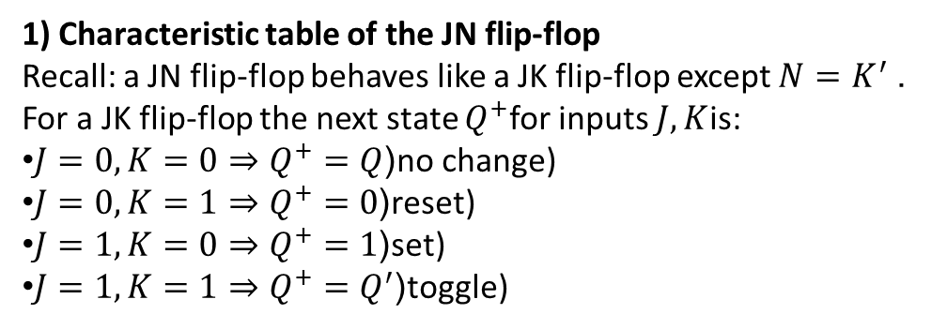
1) Characteristic table of the JN flip-flop
Recall: a JN flip-flop behaves like a JK flip-flop except $N=K^{′}$. For a JK flip-flop the next state $Q^{+}$for inputs $J,K$is:
$J=0,K=0⇒Q^{+}=Q$(no change)
$J=0,K=1⇒Q^{+}=0$(reset)
$J=1,K=0⇒Q^{+}=1$(set)
$J=1,K=1⇒Q^{+}=Q^{′}$(toggle)

Slide 14
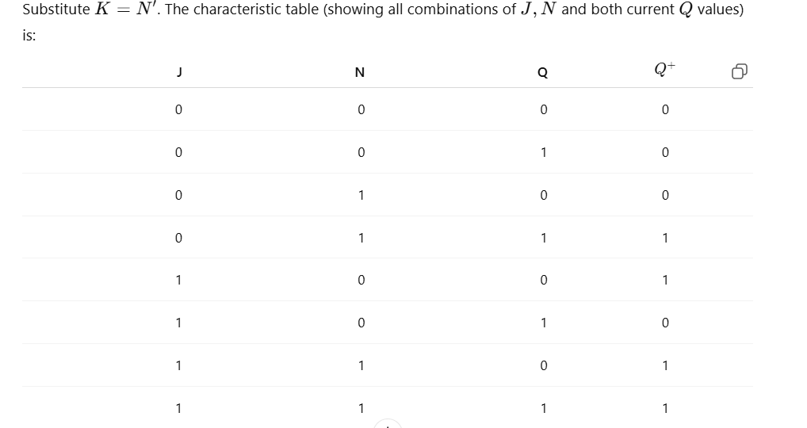

Slide 15
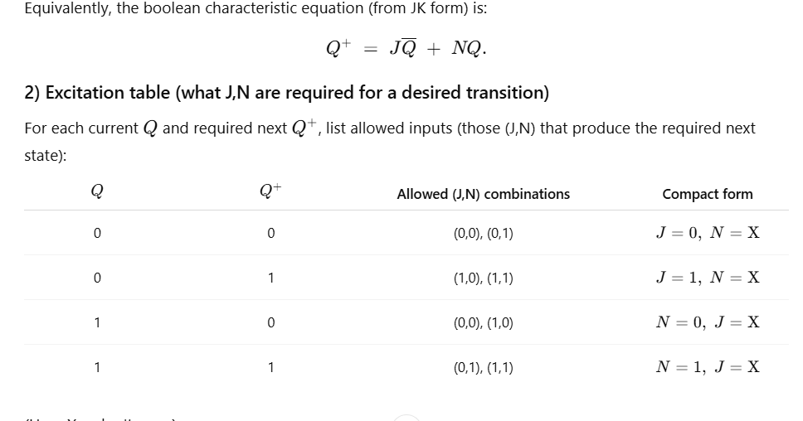

Slide 16
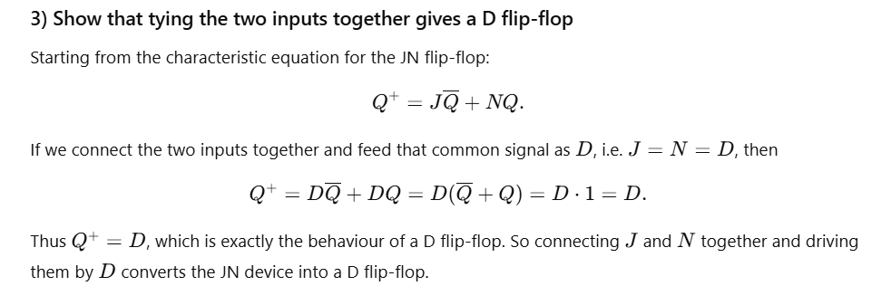

Slide 17
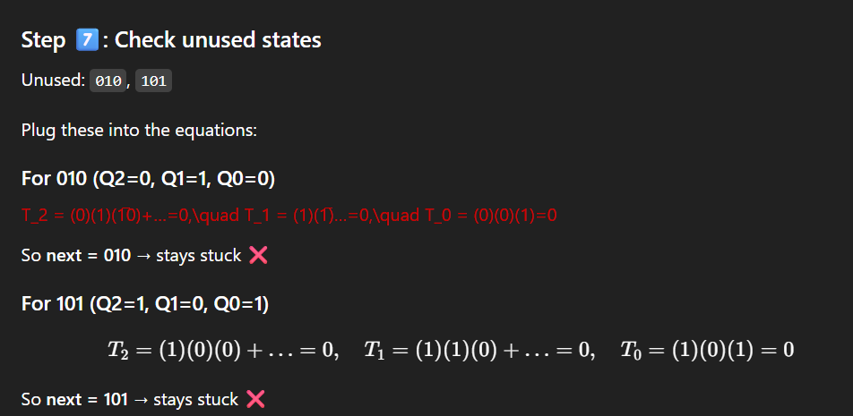
Problem:
Design with the following repeated binary sequence 0, 1, 3, 7, 6, 4. Use T FF. Check if it is self correcting

Slide 18
Home work

Slide 19
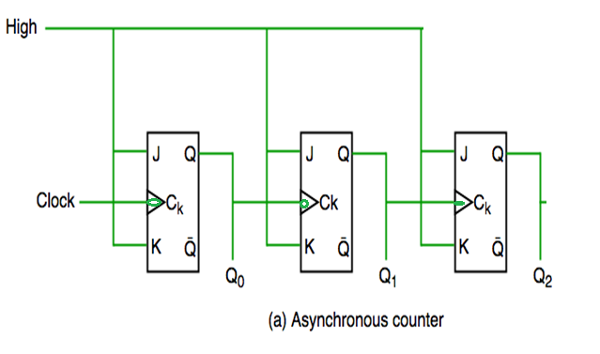
Asynchronous 3 bit UP Counter (MOD 8 ) (Binary Ripple Counter)
Ripple Counters
In asynchronous counter we don’t use universal clock, only first flip flop is driven by main clock and the clock input of rest of the following flip flop is driven by output of previous flip flops.

Slide 20
Design with T and D Flip Flops

Slide 21
Ring counter using counter and decoder
For an alternative design, the timing signals can be generated by a two‐bit counter that goes through four distinct states and a decoder. The decoder decodes the four states of the counter and generates the required sequence of timing signals.
To generate 2^{n} timing signals, we need either a shift register with 2^{n} flip‐flops or an n ‐bit binary counter together with an n‐to‐2^{n} ‐line decoder.

